Slide 1
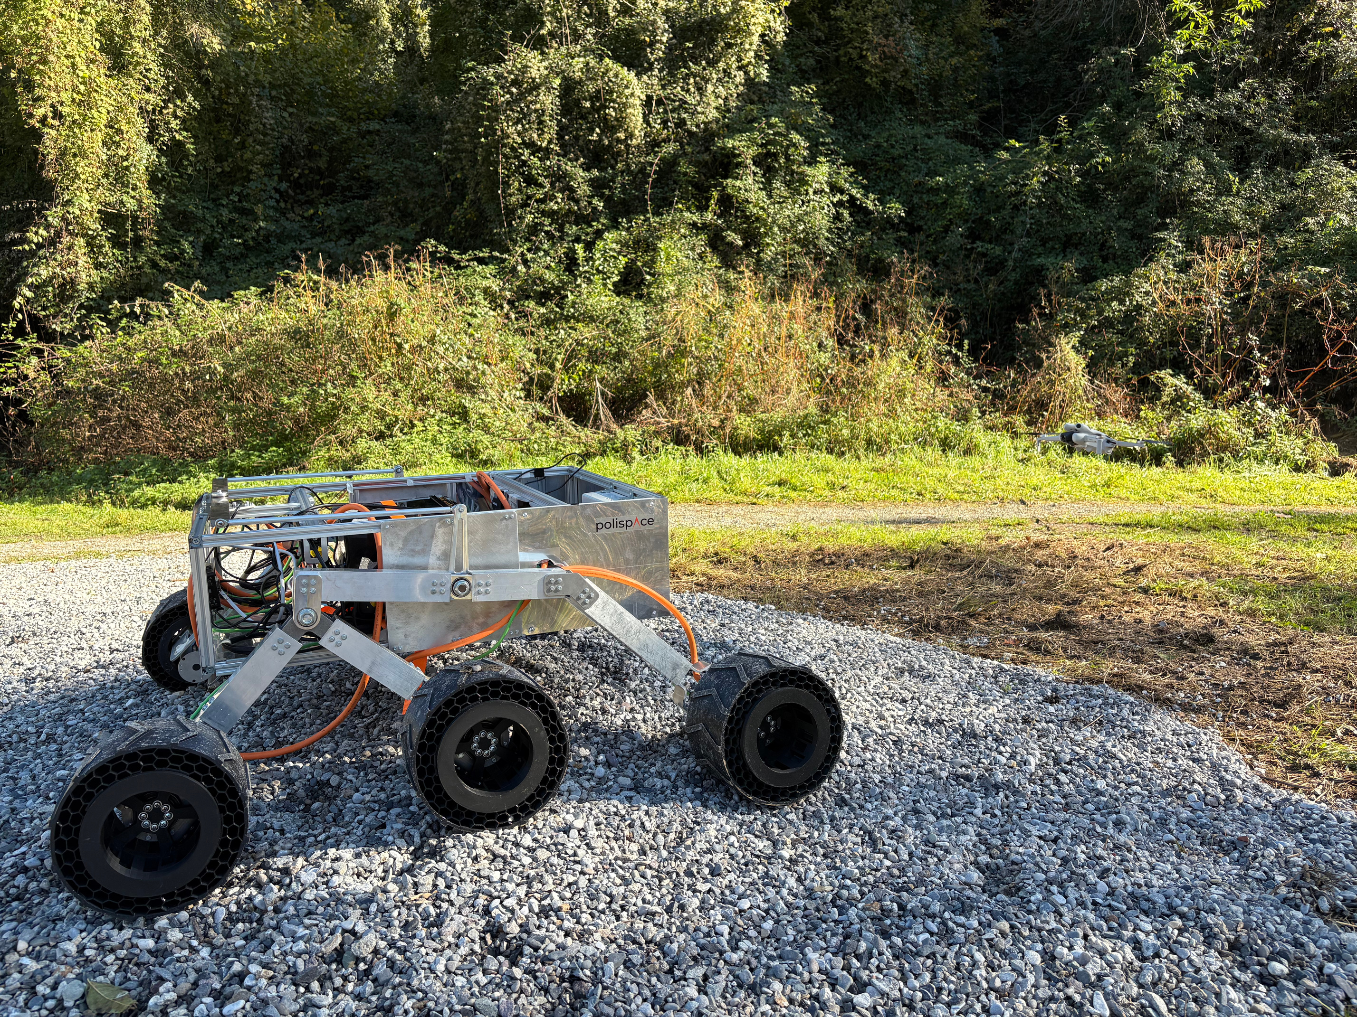


RoverTech
[R]overTech x Polispace x Suncubes Workshop
Autonomous Drones and Perception
[ ]
R
Federico De Donatis
Luca Attorrese
RoverTech

Slide 2
RoverTech
Lesson 2
FROM MEASUREMENTS
TO ATTITUDE
Sensors, Observability and Sensor Fusion

Slide 3
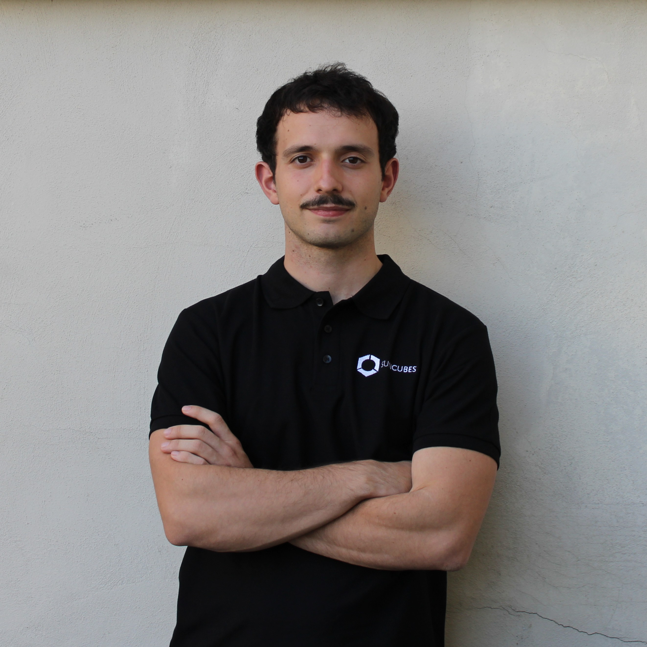
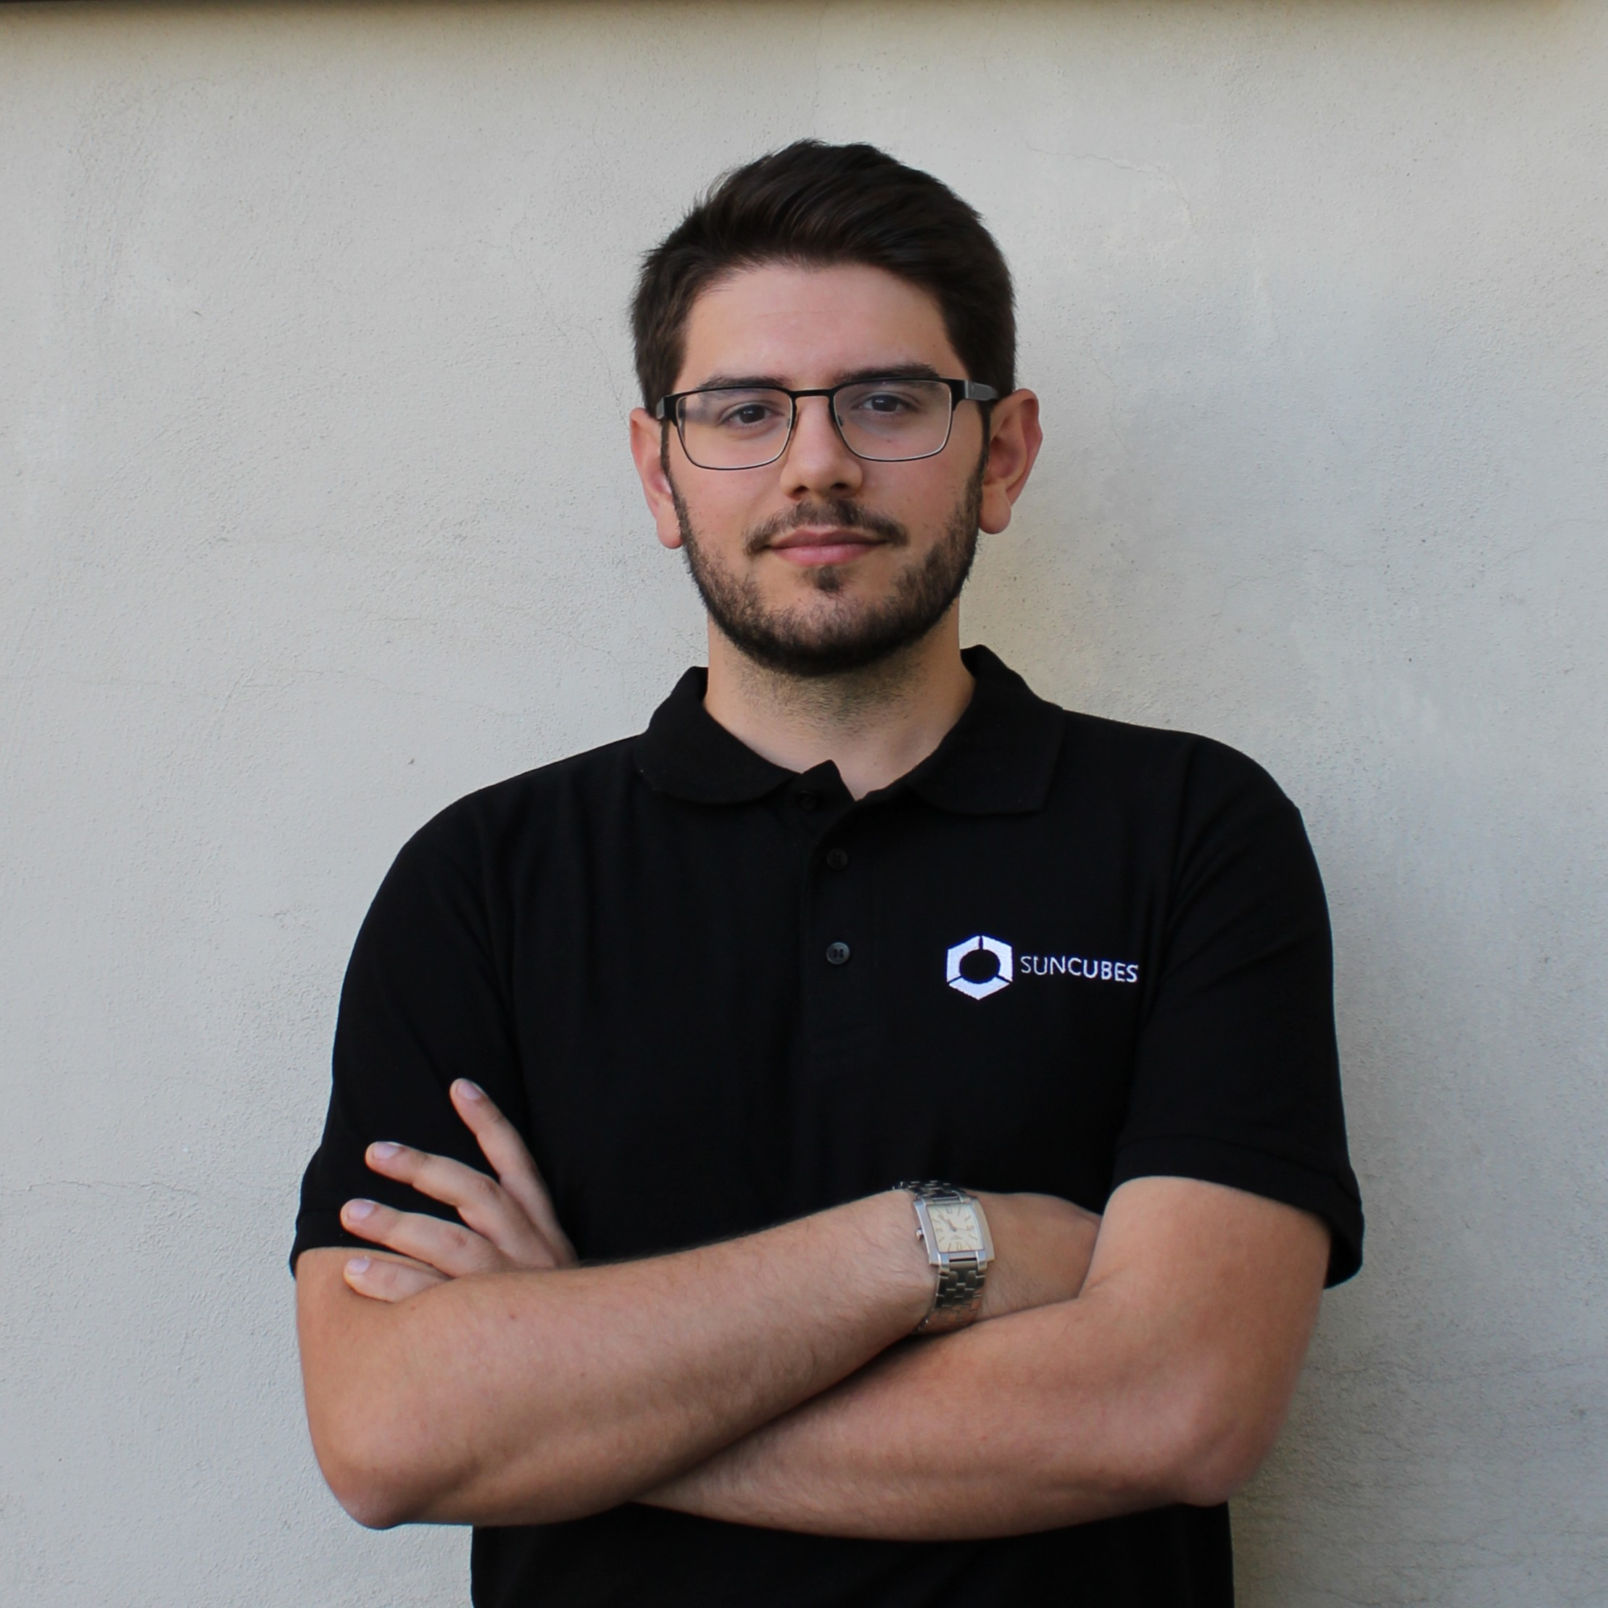
Your Speakers
Federico De Donatis
Luca Attorrese
Systems architecture & avionics integration
Robotics and perception

Slide 4



Material
FedericoDD/workshop-PX4/

Slide 5

Workshop Map
Lesson 1
Lesson 2
Lesson 3
BUILD
ESTIMATE
PERCEIVE
Hardware, PX4
IMU + EKF
Camera +
Visual Odometry
07/10
14/10
21/10

Slide 6

Frames
Attitude arrives as a quaternion
EXPLAINED IN LESSON 2
ATTITUDE ESTIMATOR
fuses IMU and other aiding sources
vehicle_attitude
$$q = [w, x, y, z]$$
INVERSE ROTATION
rotate NED gravity back into BODY
BODY GRAVITY
uORB topic with the current attitude
Hamilton quaternion, FRD → NED
Forward, Right, Down components
Don't confuse the two operations
The estimator creates the attitude; gravity_demo only reads it and changes coordinates.

Slide 7
Frames
Attitude arrives as a quaternion
ATTITUDE ESTIMATOR
fuses IMU and other aiding sources
vehicle_attitude
$$q = [w, x, y, z]$$
INVERSE ROTATION
rotate NED gravity back into BODY
BODY GRAVITY
uORB topic with the current attitude
Hamilton quaternion, FRD → NED
Forward, Right, Down components
Don't confuse the two operations
The estimator creates the attitude; gravity_demo only reads it and changes coordinates.

Slide 8
Estimation
What does estimation mean?
Infer a hidden state from measurements,
a model and uncertainty.
z
x̂

Slide 9
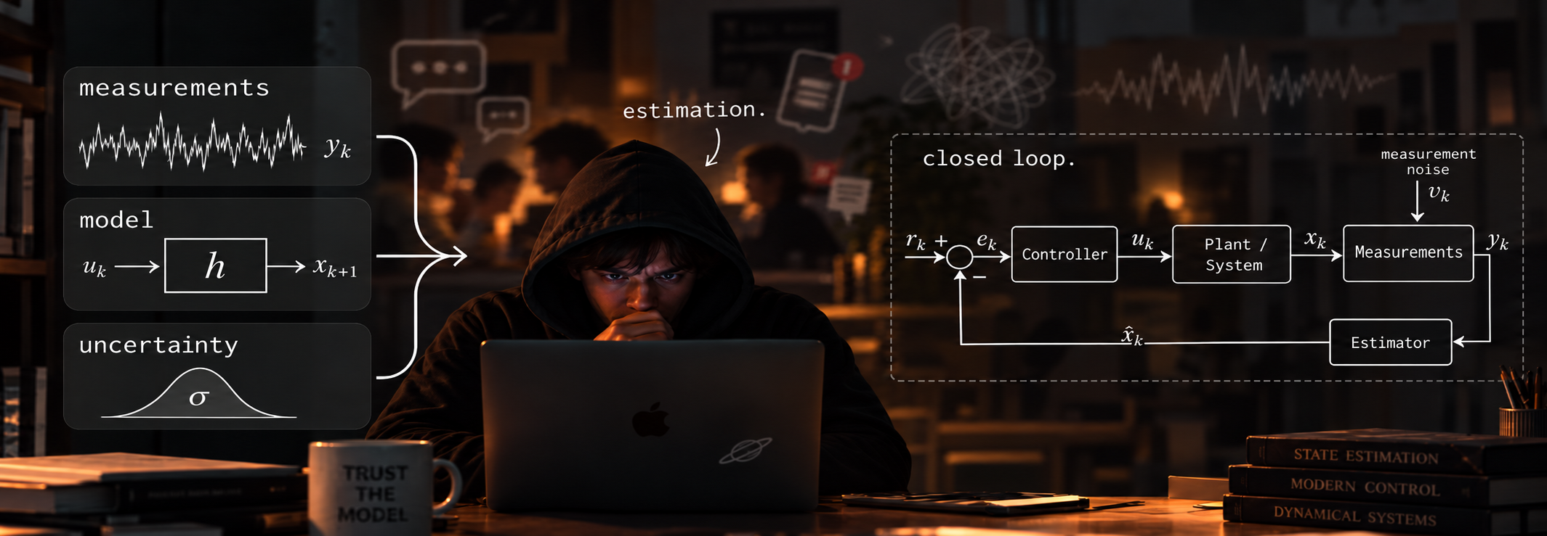
Estimation
What does estimation mean?
Infer a hidden state from measurements,
a model and uncertainty.
z
x̂

Slide 10
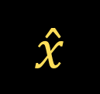
Estimation
What does estimation mean?
Infer a hidden state from measurements,
a model and uncertainty.
MEASUREMENT
z
MODEL
f, h
STATE ESTIMATE
$$\overset{ˆ}{x}$$
What sensors provide about the physical system.
How the state evolves and produces measurements.
The best current inference of the hidden state.

Slide 11
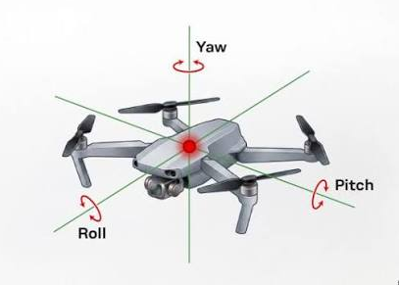
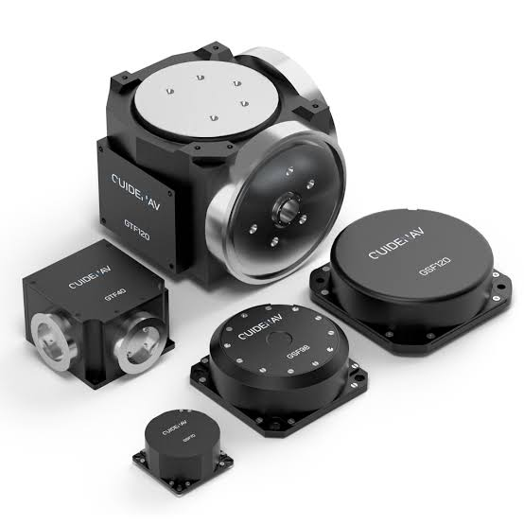
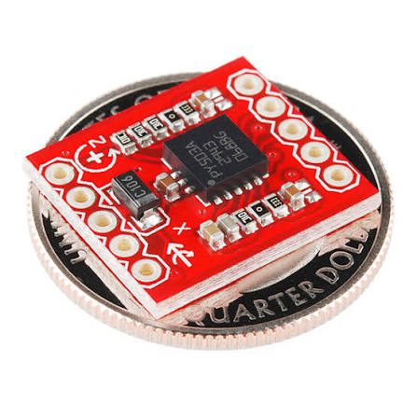
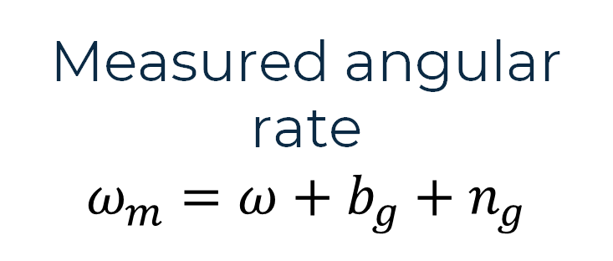
One attitude-estimation example
MEASUREMENT
Measured angular rate
$$ω_{m}=ω+b_{g}+n_{g}$$
Reference: J. Solà (2017), Quaternion kinematics for the error-state Kalman filter.

Slide 12
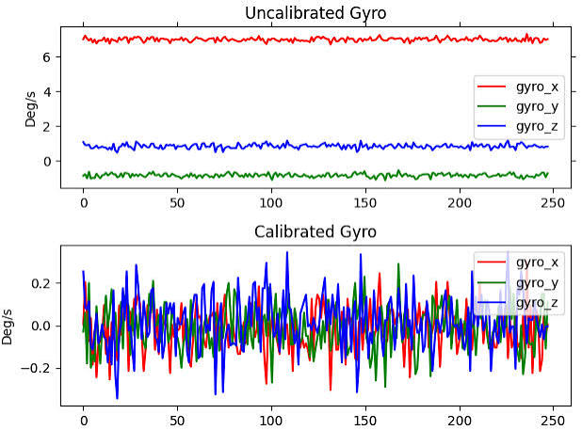
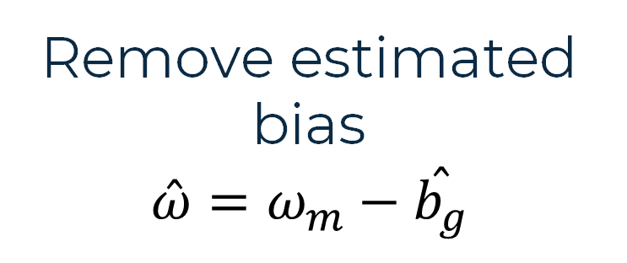
One attitude-estimation example
MEASUREMENT
MODEL
Measured angular rate
$$ω_{m}=ω+b_{g}+n_{g}$$
Remove estimated bias
$$\overset{ˆ}{ω}=ω_{m}−\overset{ˆ}{b_{g}}$$
Reference: J. Solà (2017), Quaternion kinematics for the error-state Kalman filter.

Slide 13
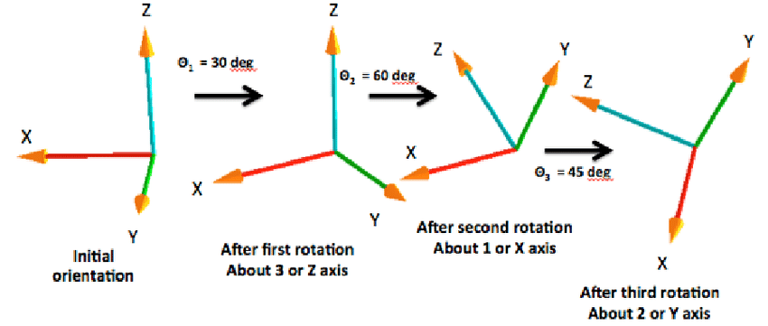
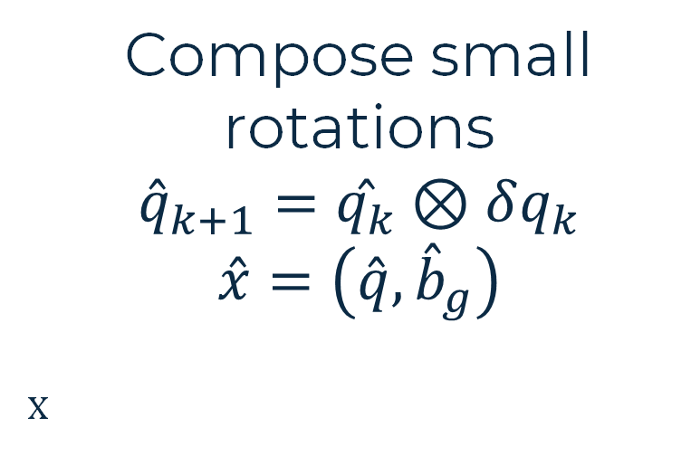
One attitude-estimation example
MEASUREMENT
MODEL
STATE ESTIMATE
Measured angular rate
$$ω_{m}=ω+b_{g}+n_{g}$$
Remove estimated bias
$$\overset{ˆ}{ω}=ω_{m}−\overset{ˆ}{b_{g}}$$
Compose small rotations
$${\overset{ˆ}{q}}_{k+1}=\overset{ˆ}{q_{k}}⊗δq_{k}$$
$$\overset{ˆ}{x}=\left(\overset{ˆ}{q},{\overset{ˆ}{b}}_{g}\right)$$
x
Reference: J. Solà (2017), Quaternion kinematics for the error-state Kalman filter.

Slide 14

Quaternion integration
Gyro rate becomes a sequence of small rotations
1 CORRECT THE RATE; INTEGRATE OVER Δt
2 MAP THE ROTATION VECTOR TO δq
$$\hat{ω}ₖ = ωₘ,ₖ − {\hat{b}}_{g,k}$$
$$θₖ = ‖δθₖ‖$$
$$uₖ = δθₖ / θₖ$$
$$δθₖ = \hat{ω}ₖ Δt$$
$$δqₖ = [cos⁡(θₖ/2); uₖ sin⁡(θₖ/2)]$$
$$θₖ ≪ 1 ⇒ δqₖ ≈ [1; ½δθₖ]$$
3 COMPOSE AND REPEAT
4 NORMALIZE
$$\hat{q}ₖ₊₁ = \hat{q}ₖ ⊗ δqₖ$$
$\hat{q}ₖ_{+1}=$ $\hat{q}ₖ_{+1}/||\hat{q}ₖ_{+1}||$
Each new gyro sample adds one small rotation to the current attitude.
Reference: J. Solà (2017), Quaternion kinematics for the error-state Kalman filter.

Slide 15
RoverTech
MEASUREMENT

Slide 16
Measurement
A sensor translates physics into electricity
“A sensor is a device that receives a stimulus and responds with an electrical signal.”
PHYSICAL
STIMULUS
SENSOR
ELECTRICAL
SIGNAL
Academic definition: J. Fraden, Handbook of Modern Sensors.

Slide 17
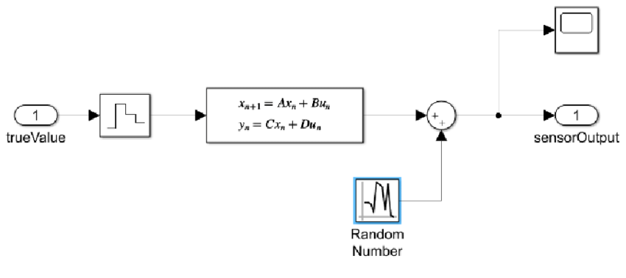
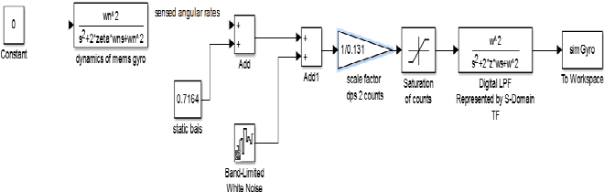
Sensors
What is a sensor?
PHYSICAL
QUANTITY
TRANSDUCER
ANALOG
SIGNAL
CONDITIONING
+ ANTI-ALIAS
ADC
DIGITAL
MEASUREMENT
Conceptual chain: transduction → conditioning → sampling → digital measurement

Slide 18
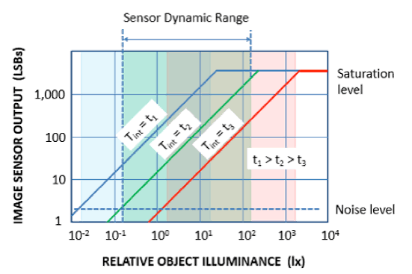
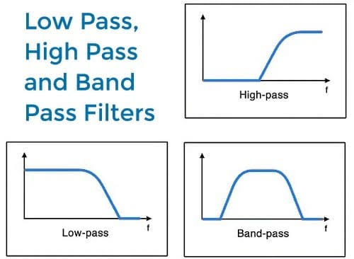
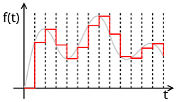
Sensors
How do I choose a sensor?
DYNAMIC WINDOW
RANGE
BANDWIDTH
ODR / SAMPLE RATE
Terminology aligned with PX4 v1.17 sensor and estimator integration documentation.

Slide 19
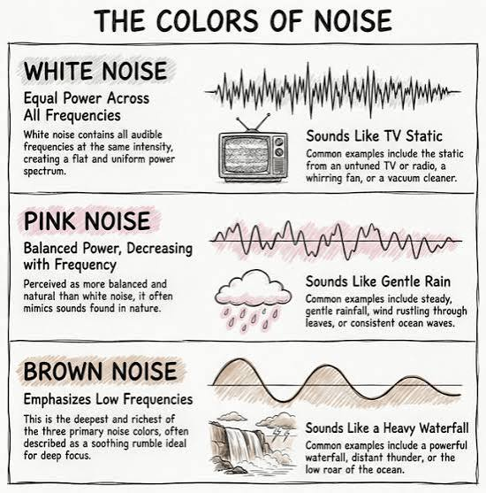
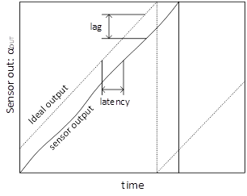
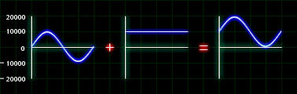
Sensors
How do I choose a sensor?
ERROR BEHAVIOUR
NOISE
BIAS
LATENCY
Terminology aligned with PX4 v1.17 sensor and estimator integration documentation.

Slide 20
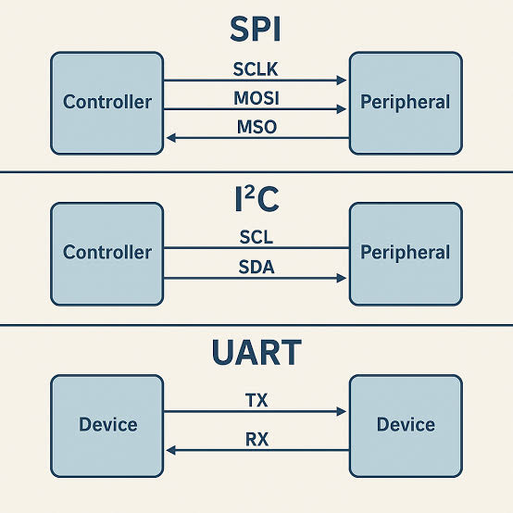
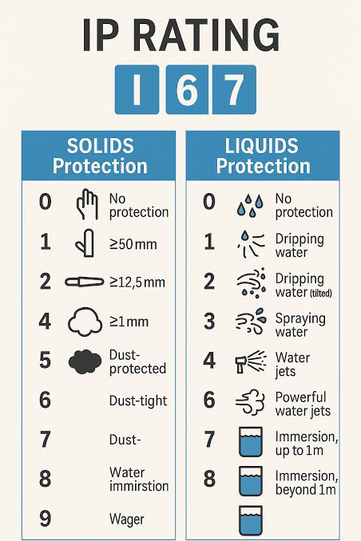
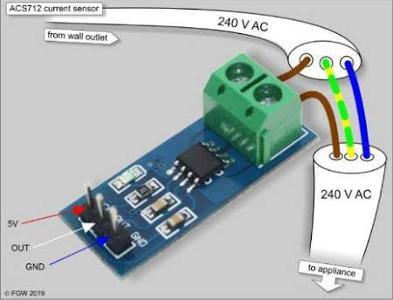
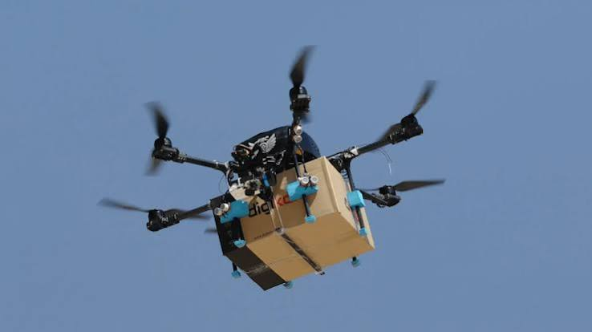
Sensors
How do I choose a sensor?
INTEGRATION
INTERFACE
POWER
MASS
ENVIRONMENT
Terminology aligned with PX4 v1.17 sensor and estimator integration documentation.

Slide 21
Sensors
How do I choose a sensor?
DYNAMIC WINDOW
RANGE
BANDWIDTH
ODR / SAMPLE RATE
ERROR BEHAVIOUR
NOISE
BIAS
LATENCY
INTEGRATION
INTERFACE
POWER
MASS
ENVIRONMENT
Which specification affects estimation quality?
Almost all of them, but in different ways.
Terminology aligned with PX4 v1.17 sensor and estimator integration documentation.

Slide 22
RoverTech
MODEL

Slide 23
Sensors
The minimum measurement model
$$z = h(x) + b + n$$
h(x)
b
n
IDEAL RELATIONSHIP
BIAS
RANDOM NOISE
how the hidden state
creates the measurement
a persistent offset
that looks like truth
unpredictable variation
around the measurement
reality adds more: scale factor · misalignment · saturation · latency
Notation follows standard estimation and inertial-navigation measurement models.

Slide 24
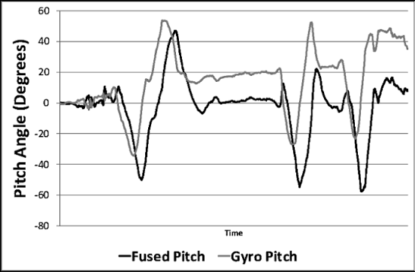
Sensors
Gyroscope
$$ωₘ=ω+b_{g}+n_{g}$$
TRUE ANGULAR RATE
INTEGRATE
+ tiny bias
rate → attitude
Rate-gyro model with additive bias and noise · Markley & Crassidis; Groves

Slide 25
Sensors
Accelerometer
$$fᴮ=Rᵀ_{(q)}\left(a^{N}−g^{N}\right)+b_{a}+n_{a}$$
Doesn’t measures roll, pitch or attitude but a specific force.
LOW DYNAMIC ACCELERATION
WHAT IF THE DRONE ACCELERATES FORWARD?
$$a ≈ 0$$
$$a ≠ 0$$
gravity direction becomes useful
→ tilt can be constrained
specific force is no longer ‘just gravity’
→ the model separates motion from gravity
Sensor fusion needs a model because the same measurement can have different causes.
Specific-force convention: standard strapdown inertial navigation · Groves; Markley & Crassidis

Slide 26
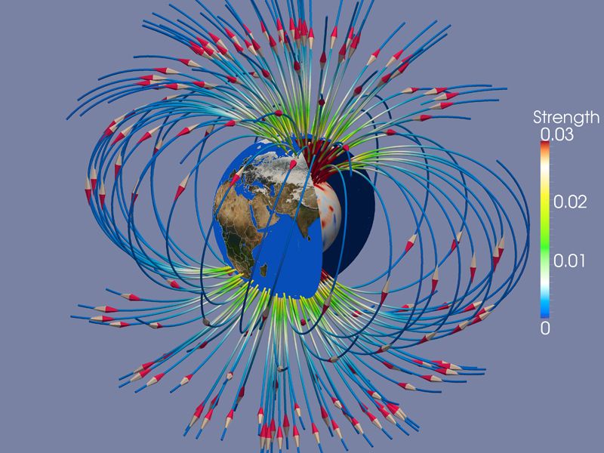
Sensors
Magnetometer
$$mᴮ=Rᵀ_{(q)}mᴺ+d+n$$
It measures the magnetic-field vector (not the yaw!).
REFERENCE
field direction may constrain heading
Vector observation model for attitude determination · Shuster; Markley & Crassidis

Slide 27
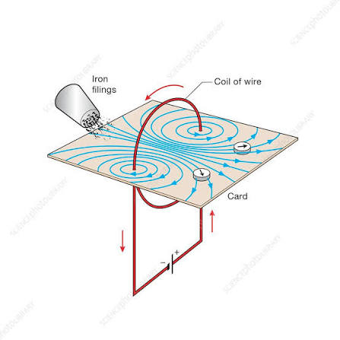
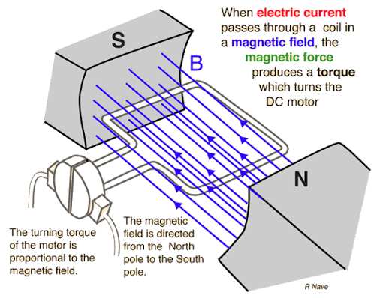
Sensors
Magnetometer
$$mᴮ=Rᵀ_{(q)}mᴺ+d+n$$
It measures the magnetic-field vector (not the yaw!).
REFERENCE
CORRUPTION
field direction may constrain heading
motors · current · nearby ferromagnetic material
Vector observation model for attitude determination · Shuster; Markley & Crassidis

Slide 28
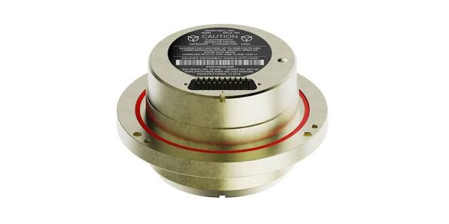
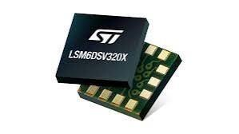
Sensors
9-DoF IMU or 6-DoF + remote mag?
Both: 3 gyro + 3 accel + 3 magnetic axes
Same axes; different magnetic exposure and integration effort.
9-DOF INTEGRATED MODULE
6-DOF IMU + REMOTE MAG
PRO: Compact; fewer cables
PRO: Place mag away from current
CON: Fixed mag location can limit isolation from motors and power wiring.
CON: More wiring; align frames and manage timing/calibration.
Sources: Bosch Sensortec, BNO055; PX4, Mounting a GPS/Compass.

Slide 29
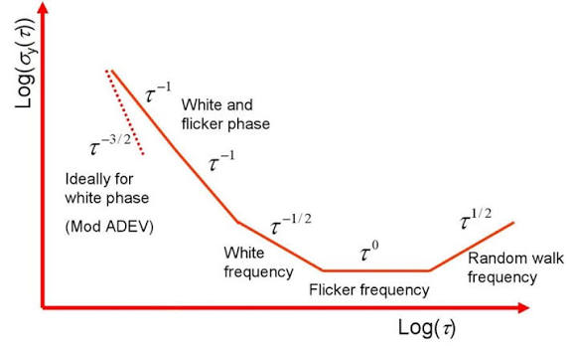
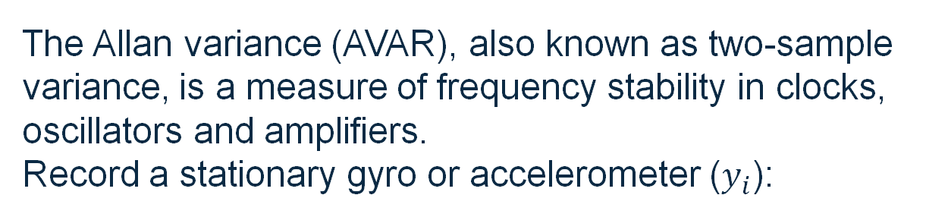
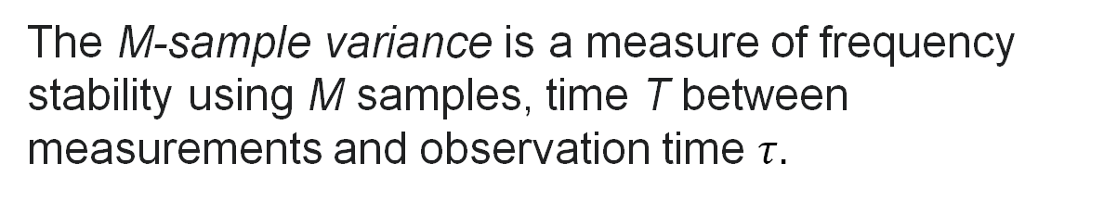
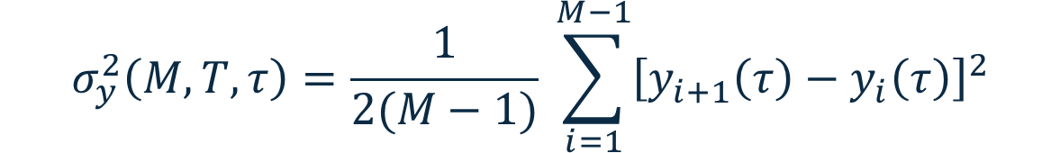
Sensors
Allan variance reveals sensor noise by time scale
COMPARE ADJACENT TIME WINDOWS
The Allan variance (AVAR), also known as two-sample variance, is a measure of frequency stability in clocks, oscillators and amplifiers.
Record a stationary gyro or accelerometer ($y_{i}$):
$$σ_{y}^{2}\left(M,T,τ\right)=\frac{1}{2(M−1)} \sum_{i=1}^{M−1}{{\left[y_{i+1}\left(τ\right)−y_{i}\left(τ\right)\right]}^{2}}$$
The M-sample variance is a measure of frequency stability using M samples, time T between measurements and observation time $τ.$
Sources: NIST, Time and Frequency from A to Z; MathWorks, Inertial Sensor Noise Analysis Using Allan Variance.

Slide 30
Sensors
One state, many sources
ATTITUDE
←
GYRO
GRAVITY
MAGNETIC FIELD
VISION
HEIGHT
←
BAROMETER
GNSS
RANGE
VISION
HORIZONTAL MOTION
←
GNSS
OPTICAL FLOW
VIO

Slide 31
Sensors
One state, many sources
ATTITUDE
←
GYRO
GRAVITY
MAGNETIC FIELD
VISION
HEIGHT
←
BAROMETER
GNSS
RANGE
VISION
HORIZONTAL MOTION
←
GNSS
OPTICAL FLOW
VIO
If every sensor is incomplete, maybe the information is in the combination.
SENSOR FUSION

Slide 32
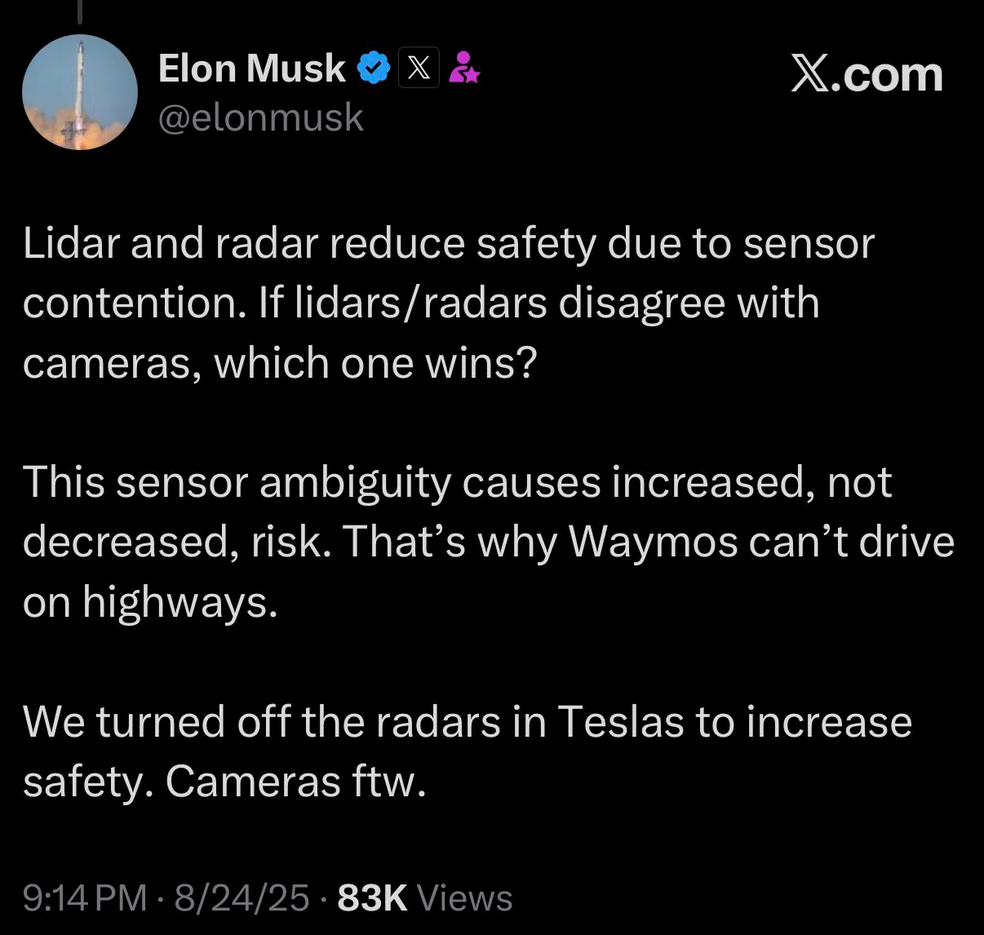
Sensors
WHY ONE SENSOR IS NOT ENOUGH

Slide 33
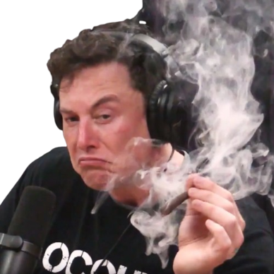
Sensors
WHY ONE SENSOR IS NOT ENOUGH

Slide 34
Sensors
WHY ONE SENSOR IS NOT ENOUGH
GYROSCOPE
ACCELEROMETER
MAGNETOMETER
good short-term angular information
gravity reference for tilt
heading information
but bias causes drift
but dynamic acceleration corrupts it
but magnetic disturbances corrupt it
No sensor is wrong BUT no sensor is enough.

Slide 35
RoverTech
ESTIMATION

Slide 36

Estimation
SENSOR FUSION
No sensor is wrong BUT no sensor is enough.
GYROSCOPE
STATE ESTIMATE
ACCELEROMETER
$\hat{q} · {\hat{b}}_{g} · uncertainty$
MAGNETOMETER
Combine complementary measurements according to their uncertainty.
When model and measurements disagree, who should we trust?

Slide 37
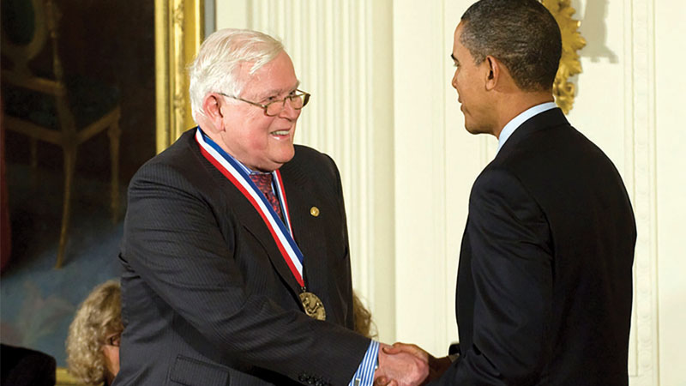
Estimation
FROM KALMAN TO FLIGHT
RUDOLF E. KALMAN
STANLEY F. SCHMIDT
1960
EARLY AEROSPACE APPLICATIONS
Recursive state-estimation framework
Implementation and practical nonlinear navigation work at NASA Ames
A mathematical idea became an engineering tool because aerospace needed navigation in the real world.
MODEL + MEASUREMENT + UNCERTAINTY
KALMAN FILTER

Slide 38
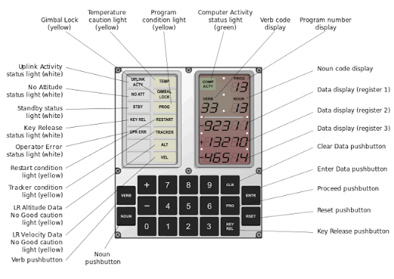
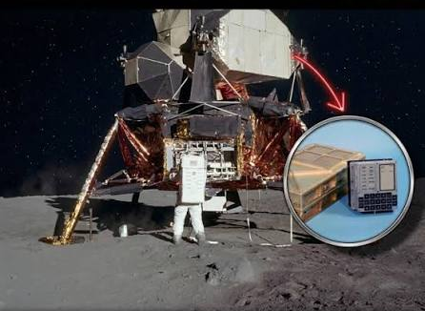
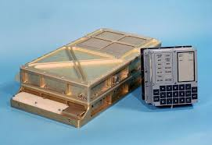
Estimation
APOLLO GUIDANCE COMPUTER
CPU 2 MHz (16-bit) - RAM 4 KB - ROM 74 KB - Peso 32 kg - Consumo 55W

Slide 39


Estimation
AN ESTIMATE IS NOT JUST A NUMBER
$$\hat{x}$$
$$\hat{P}$$
best current state estimate
covariance / uncertainty associated with the estimate

Slide 40
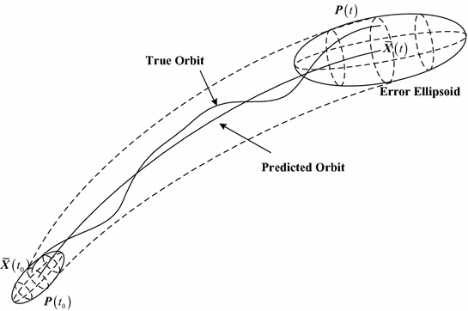
Estimation
AN ESTIMATE IS NOT JUST A NUMBER
$$\hat{x}$$
$$\hat{P}$$
best current state estimate
covariance / uncertainty associated with the estimate

Slide 41






Estimation
THE KALMAN FILTER IN TWO VERBS
PREDICT
CORRECT
PREDICT
CORRECT
$$−$$
$$+$$
$$−$$
$$+$$
MODEL
MEASUREMENT MODEL
MODEL
MEASUREMENT MODEL
MEASUREMENT
MEASUREMENT
$$z$$
$$z$$
If prediction and measurement disagree, who wins?
Neither automatically.
The less uncertain information gets more authority.

Slide 42


Estimation
PREDICT
$$\hat{x}ₖ⁻ = F \hat{x}ₖ₋₁⁺$$
$$Pₖ⁻ = F Pₖ₋₁⁺ Fᵀ + Q$$
STATE
UNCERTAINTY
Q
Where does the model think we moved?
How uncertain did we become while moving?
What uncertainty in the evolution does the model admit?
Prediction moves both the estimate and its uncertainty.

Slide 43

Estimation
INNOVATION
$$r = z − h(\hat{x}⁻)$$
WHAT I MEASURED
−
WHAT I EXPECTED TO MEASURE
If the innovation is unexpectedly large, is the sensor wrong, the model wrong, or both?

Slide 44
Estimation
CORRECT
$$K = P⁻ Hᵀ (H P⁻ Hᵀ + R)⁻¹$$
$$\hat{x}⁺ = \hat{x}⁻ + K r$$
LARGE R
LARGE P⁻
measurement gets less authority
measurement gets more authority
Kalman filtering is uncertainty-aware feedback on information.

Slide 45
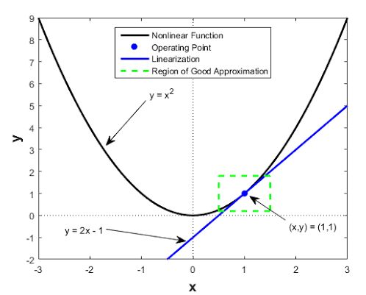

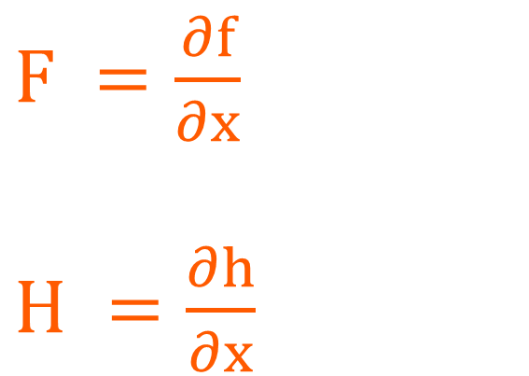

Estimation
SO WHY “EXTENDED”?
NONLINEAR MODEL
LOCAL LINEAR VIEW
$$xₖ₊₁ = f(xₖ, uₖ) + wₖ$$
$F =\frac{∂f}{∂x}$
$H =\frac{∂h}{∂x}$
$$zₖ = h(xₖ) + vₖ$$
The EKF does not make the world linear. It linearises our uncertainty locally around the current estimate.

Slide 46
Estimation
FROM CONTINUOUS DYNAMICS TO F
$$ẋ = Ax + Bu$$
$$(xₖ₊₁ − xₖ)/Δt ≈ Axₖ + Buₖ$$
FORWARD EULER
IDENTIFY F
$$xₖ₊₁ ≈ (I + AΔt)xₖ + BΔt uₖ$$
$$F ≈ I + AΔt$$
With constant A, the exact transition is F = exp(AΔt).

Slide 47
Estimation
DIFFERENT PHYSICS, DIFFERENT ESTIMATORS
BEYOND TODAY
MEKF / ERROR STATE
local attitude-error representation
AUGMENTED STATE
biases / coloured stochastic processes
UKF
sigma-point propagation through nonlinear mappings
DUAL / JOINT ESTIMATION
states + parameters
TOBIT / CENSORED FILTERING
censored or saturated measurements
Different physics can require different states, stochastic models and approximations.

Slide 48
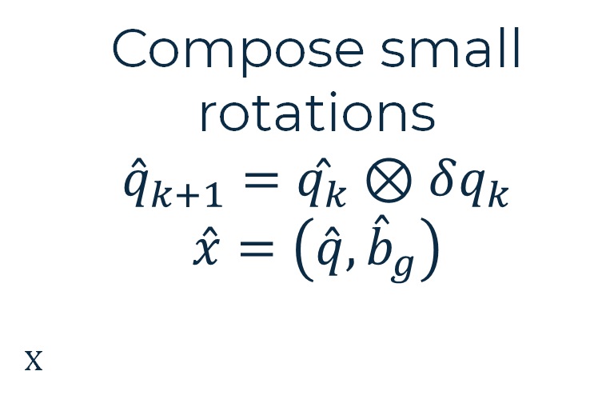
Quaternions
DEFINITION · SCALAR-FIRST CONVENTION
STATE ESTIMATE
q = [q₀; q₁, q₂, q₃]
Compose small rotations
$${\overset{ˆ}{q}}_{k+1}=\overset{ˆ}{q_{k}}⊗δq_{k}$$
$$\overset{ˆ}{x}=\left(\overset{ˆ}{q},{\overset{ˆ}{b}}_{g}\right)$$
x
q₀ = cos(θ/2)
[q₁,q₂,q₃] = u sin(θ/2)
θ = rotation angle, ‖u‖ = 1 , ‖q‖ = 1
PRO / WHY USE THEM
CONS / WHAT TO MANAGE
No Euler-angle gimbal lock; small rotations compose with ⊗.
4 values for 3 DOF; renormalize. q and −q encode the same rotation.
Source: J. Solà (2017), Quaternion kinematics for the error-state Kalman filter.

Slide 49
Quaternions
DEFINITION · SCALAR-FIRST CONVENTION
STATE ESTIMATE
q = [q₀; q₁, q₂, q₃]
Compose small rotations
$${\overset{ˆ}{q}}_{k+1}=\overset{ˆ}{q_{k}}⊗δq_{k}$$
$$\overset{ˆ}{x}=\left(\overset{ˆ}{q},{\overset{ˆ}{b}}_{g}\right)$$
x
q₀ = cos(θ/2)
[q₁,q₂,q₃] = u sin(θ/2)
θ = rotation angle, ‖u‖ = 1 , ‖q‖ = 1
DEFINITION · SMALL ROTATIONS
$$δθ_{k} = {\hat{ω}}_{k} Δt [rad] θ_{k}=‖δθ_{k}‖ u_{k} =δθ_{k}/θ_{k} (θ > 0)$$
Source: J. Solà (2017), Quaternion kinematics for the error-state Kalman filter.

Slide 50





Estimation
PREDICT WITH THE GYROSCOPE
$$\hat{ω} = ωₘ − {\hat{b}}_{g}$$
$$\hat{q}ₖ₊₁⁻ = \hat{q}ₖ⁺ ⊗ Exp(δ\hat{θ})$$
GYRO
REMOVE ESTIMATED BIAS
INTEGRATE ROTATION
PREDICT ATTITUDE
$$ωₘ$$
$$\hat{ω} = ωₘ − {\hat{b}}_{g}$$
$$Exp(δ\hat{θ})$$
$${\hat{q}}_{k+1}^{−}$$
Excellent short-term information. But prediction alone drifts.

Slide 51


Estimation
OUR MINIMAL ESTIMATOR
$$δx = [δθ δb_{g}]$$
$$δθ$$
attitude correction
$$δb_{g}$$
gyro-bias correction
GYRO
ACCELEROMETER
MAGNETOMETER
PREDICT
CORRECT TILT
AID HEADING
Let’s start with prediction.

Slide 52
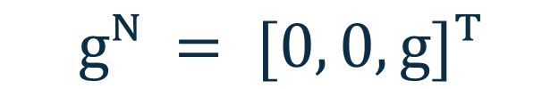

Estimation
GRAVITY COMES BACK
LESSON 1
gravity in NED
rotate into BODY
measurement model
GRAVITY IN NED
PREDICTED GRAVITY IN BODY
ACCELEROMETER
$$gᴺ = [0, 0, g]ᵀ$$
$$ĝᴮ = R(q̂)ᵀ gᴺ$$
information compatible with gravity
when dynamic acceleration is sufficiently compatible with the model
The coordinate transformation from Lesson 1 has become a measurement model.

Slide 53
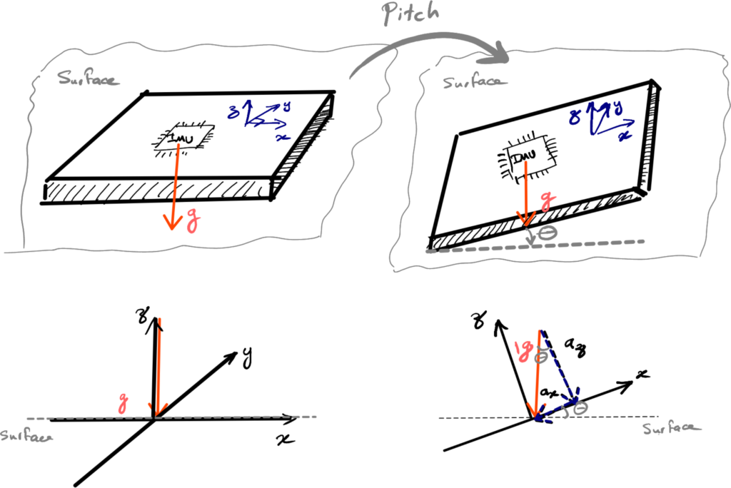
Estimation
SOMETHING IS STILL MISSING
Gyroscope + accelerometer. Do we now know full attitude?
ROTATE AROUND GRAVITY
ROLL
constrained by gravity
PITCH
constrained by gravity
YAW
not absolutely constrained by gravity
Rotating around gravity does not change the gravity vector.

Slide 54
Estimation
GIVE HEADING A REFERENCE
So what information could constrain heading?
MAGNETIC FIELD
VISION
GNSS-BASED HEADING
MAGNETOMETER
External vision / VIO
suitable hardware + geometry
magnetic-field vector
external geometric reference
heading information when observable
OUR EDUCATIONAL ESTIMATOR

Slide 55
Navigation
What is still missing?
WHERE IT IS
HOW FAST IT MOVES
HOW IT IS ORIENTED
A drone may know
its own state
What does it know about the world around it?
PERCEPTION
CAMERA
DEPTH
LiDAR
Navigation estimates the vehicle. Perception interprets the environment.
LESSON 3

Slide 56
Navigation
How high are we?
BAROMETER
GNSS
RANGEFINDER
EXTERNAL VISION
MEASURES
static pressure
MEASURES
signal travel time
MEASURES
distance to a surface
MEASURES
image features / pose
USEFUL
smooth relative height
USEFUL
global altitude outdoors
USEFUL
low altitude + landing
USEFUL
prepared environments
LIMIT
weather + propwash drift
LIMIT
noise · geometry · outages
LIMIT
range + surface geometry
LIMIT
lighting · coverage · latency
Height is a state. Each sensor observes it differently.
One physical quantity · four incomplete information sources

Slide 57
Navigation
How fast are we moving sideways?
GNSS VELOCITY
OPTICAL FLOW
VIO / EXTERNAL VISION
Measures change in the global navigation solution
Measures apparent image motion over the ground
Combines visual motion with inertial or external pose
Best when:
open sky + global reference
Best when:
texture + known height
Best when:
GNSS is weak or unavailable
Watch:
geometry · outages · latency
Watch:
lighting · altitude · surface
Watch:
compute · calibration · drift
Velocity sources answer different questions under different operating conditions

Slide 58
RoverTech
PX4

Slide 59
Navigation
How does a measurement reach PX4?
SENSOR
INTERFACE
DRIVER
uORB
MODULE
physical
measurement
SPI · I²C
UART · CAN
read · timestamp
calibrate · publish
typed
software topic
subscribe
check · fuse
Official PX4 v1.17 docs · Drivers publish sensor data through uORB; interface depends on device and bus

Slide 60
Estimation
OUR FILTER IS NOT PX4 EKF2
OUR EDUCATIONAL FILTER
PX4 EKF2
ATTITUDE
FULL NAVIGATION ESTIMATOR
GYROSCOPE BIAS
ATTITUDE · VELOCITY · POSITION
ACCELEROMETER AIDING
SENSOR BIASES
MAGNETOMETER AIDING
MULTIPLE AIDING SOURCES
small enough to see every idea
real navigation scope

Slide 61
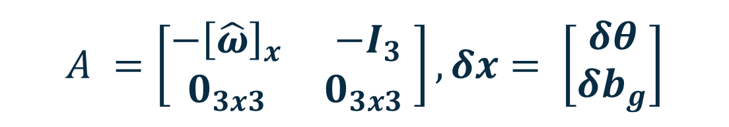
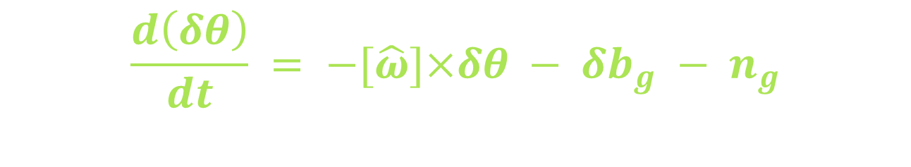

Estimation
PREDICTION: FROM GYROSCOPE TO STATE TRANSITION
A RIGHT-MULTIPLICATIVE LOCAL ERROR
Attitude error: $δR={\overset{ˆ}{R}}^{⊤}R e \dot{\overset{ˆ}{R}}=\overset{ˆ}{R}{\left[\overset{ˆ}{ω}\right]}_{×}→\dot{δR}={\dot{\overset{ˆ}{R}}}^{⊤}R+{\overset{ˆ}{R}}^{⊤}\dot{R}=−{\left[\overset{ˆ}{ω}\right]}_{×}δ\hat{R}+δR{\left[ω\right]}_{×}$
Linearization: $δR≃I+{\left[δθ\right]}_{×} e {\left[a\right]}_{×}{\left[b\right]}_{×}−{\left[b\right]}_{×}{\left[a\right]}_{×}={\left[a×b\right]}_{×}$
$→$ ${\left[δ\dot{θ}\right]}_{×}≃−{\left[\overset{ˆ}{ω}\right]}_{×}\left(I+{\left[δθ\right]}_{×}\right)\&+\left(I+{\left[δθ\right]}_{×}\right){\left[\overset{ˆ}{ω}+δω\right]}_{×}$= ${\left[δ\dot{θ}\right]}_{×}={\left[δω−\overset{ˆ}{ω}×δθ\right]}_{×}$
$$\frac{d\left(δθ\right)}{dt} = −[\hat{ω}]×δθ − δb_{g} − n_{g}$$
B - LINEAR MODEL
C – DISCRETE LINEAR MODEL
$$δ \dot{x}= A δx +w$$
$$A =\left[\begin{matrix}−{\left[\hat{ω}\right]}_{x} & −I_{3} \\ 0_{3x3} & 0_{3x3} \end{matrix}\right], δx= \left[\begin{matrix}δθ \\ δb_{g}\end{matrix}\right]$$
$$F ≃ I₆ + A Δt$$
R(q): BODY/FRD → NED
Notes:
~90 seconds. Define gyro measurement omega_m=omega+b_g+n_g in rad/s; the code receives vehicle_imu.delta_angle in radians, dt=delta_angle_dt·10^-6 seconds, then forms measured rate dangle/dt after deliberately adding kDemoYawBiasRadS·dt to its z increment (+0.5 degree/s for the demo). Let delta-b=b_true-b_hat, q_true≈q_hat⊗delta_q(delta-theta), and omega_hat=omega_m-b_hat. With a right-multiplicative BODY-frame small error, differentiating q_true=q_hat⊗delta_q and keeping first-order terms yields delta-dot-theta≈-[omega_hat]_cross delta-theta-delta-b-n_g; bias error is modelled as a random walk, delta-dot-b≈w_b. Thus A=[-[omega_hat]_cross,-I3;0,0], the upper-right -I3 dt in F makes bias error accumulate as attitude error. The actual implementation constructs F by subtracting skew(rate)·dt in its upper-left block and setting F[i][i+3]=-dt. It uses F≈I+A dt and P_minus=F P_plus F^T+Q_k; Q_k is a first-order diagonal approximation, not an exact matrix exponential/discretization. The nominal estimate uses q_hat_minus=q_hat_plus⊗Exp_q(omega_hat dt), implemented with Q4::delta(rate*dt) and normalization in AttitudeFilter::predict(). The body-to-NED quaternion is unit norm; Exp_q(dtheta)=[cos(|dtheta|/2),sin(|dtheta|/2) dtheta/|dtheta|], with its small-angle branch. Bias estimate is held constant in prediction. This is kinematics driven by measured angular motion: no rigid-body inertia or torque equation.
DERIVATION — RIGHT-MULTIPLICATIVE BODY ERROR
R_true = R_hat Exp([δθ]×), E = R_hatᵀ R_true ≃ I + [δθ]×. Here R maps BODY/FRD to NED, and δθ is a BODY-frame right-multiplicative local error. With Ṙ_true = R_true[ω_true]× and Ṙ_hat = R_hat[ω_hat]×, differentiating E gives Ė = −[ω_hat]× E + E[ω_true]× exactly.
The measured gyro reads ω_m = ω_true + b_g,true + n_g, while ω_hat = ω_m − b_hat_g. Define δb_g = b_g,true − b_hat_g; therefore ω_true = ω_hat − δb_g − n_g. Substitute E ≃ I+[δθ]× into Ė and retain first-order terms: [δθ̇]× = −[ω_hat]×[δθ]× + [δθ]×[ω_hat]× − [δb_g+n_g]× = −[ω_hat×δθ]× − [δb_g+n_g]×.
Consequently δθ̇ = −[ω_hat]×δθ − δb_g − n_g. If the nominal bias is held constant and true bias is a random walk, δḃ_g = w_b. For δx=[δθ;δb_g], A has 3×3 blocks Aθθ=−[ω_hat]×, Aθb=−I₃, Abθ=0, Abb=0; w=[−n_g;w_b]. The upper-right minus sign follows δb_g=b_true−b_hat: overestimating bias lowers ω_hat and makes the true-minus-nominal attitude error grow. Left-multiplicative or nominal-minus-true error conventions change signs; do not mix them. F≈I₆+AΔt and P⁻=FP⁺Fᵀ+Q are covariance prediction, not propagation of the unknown true δx.

Slide 62
Estimation
ACCELEROMETER: THE FIRST MEASUREMENT MODEL
PHYSICS $fᴮ = R\left(q\right)ᵀ \left( aᴺ − gᴺ \right)+b_{a}+n_{a}$
QUASI-STATIC: $aᴺ ≃ 0 · gᴺ = (0, 0, +g)ᵀ$
$$zₐ = fᴮ / ‖fᴮ‖$$
$$hₐ(q̂) = R(q̂)ᵀ [ 0, 0, −1 ]ᵀ$$
$$νₐ = zₐ − hₐ(q̂) Hₐ = [ {\left[hₐ\right]}_{x} 0_{3x3} ]$$
Notes:
~75 seconds. An accelerometer senses specific force f^B=R(q)^T(a^N-g^N), not acceleration a^N directly: at rest in NED g^N=(0,0,+9.80665 m/s²) and a^N≈0, so f^B≈-R(q)^T g^N. Code bridge: attitude_lab.cpp constructs specific_force=imu.delta_velocity/dt_acc, where dt_acc=imu.delta_velocity_dt×10^-6 s; attitude_filter.hpp correct_accel() forms z_a=f^B/||f^B|| and h_a(q_hat)=q_hat.inverse_rotate((0,0,-1))=R(q_hat)^T(0,0,-1). For right-multiplicative q_true≈q_hat⊗delta_q(delta-theta), R(q_true)^T g≈(I-[delta-theta]_cross)h≈h+[h]_cross delta-theta, giving H_a=[[h_a]_cross,0_(3×3)] with a positive skew(h) block, exactly the implemented update_vector() Jacobian. The innovation is nu_a=z_a-h_a. Gravity is invariant to rotations about its own direction, so this observation alone does not fix yaw. The implementation rejects ||f|| outside [0.85g,1.15g] and normalized innovation norm >0.7; these are heuristic gates and do not prove absence of translational acceleration. During acceleration, a^N is nonzero and interpreting normalized specific force as gravity biases tilt. R(q) is a rotation matrix, while R_a denotes measurement noise covariance; q_hat^- and q_hat^+ are pre- and post-correction estimates. The 0.07²I₃ covariance is in normalized-vector units, not (m/s²)².

Slide 63

Estimation
MAGNETOMETER: MAKING YAW OBSERVABLE
PHYSICS $zₘᴮ = R(q)ᵀ mᴺ + bₘ + nₘ$
$$hₘ(q̂) = R\left(\hat{q}\right)ᵀ {\hat{m}}_{ref}ᴺ$$
$$νₘ = zₘ − hₘ\left(\hat{q}\right)$$
$$Hₘ = [ {\left[hₘ\right]}_{x} 0_{3x3} ]$$
Notes:
~75 seconds. An accelerometer senses specific force f^B=R(q)^T(a^N-g^N), not acceleration a^N directly: at rest in NED g^N=(0,0,+9.80665 m/s²) and a^N≈0, so f^B≈-R(q)^T g^N. Code bridge: attitude_lab.cpp constructs specific_force=imu.delta_velocity/dt_acc, where dt_acc=imu.delta_velocity_dt×10^-6 s; attitude_filter.hpp correct_accel() forms z_a=f^B/||f^B|| and h_a(q_hat)=q_hat.inverse_rotate((0,0,-1))=R(q_hat)^T(0,0,-1). For right-multiplicative q_true≈q_hat⊗delta_q(delta-theta), R(q_true)^T g≈(I-[delta-theta]_cross)h≈h+[h]_cross delta-theta, giving H_a=[[h_a]_cross,0_(3×3)] with a positive skew(h) block, exactly the implemented update_vector() Jacobian. The innovation is nu_a=z_a-h_a. Gravity is invariant to rotations about its own direction, so this observation alone does not fix yaw. The implementation rejects ||f|| outside [0.85g,1.15g] and normalized innovation norm >0.7; these are heuristic gates and do not prove absence of translational acceleration. During acceleration, a^N is nonzero and interpreting normalized specific force as gravity biases tilt. R(q) is a rotation matrix, while R_a denotes measurement noise covariance; q_hat^- and q_hat^+ are pre- and post-correction estimates. The 0.07²I₃ covariance is in normalized-vector units, not (m/s²)².

Slide 64




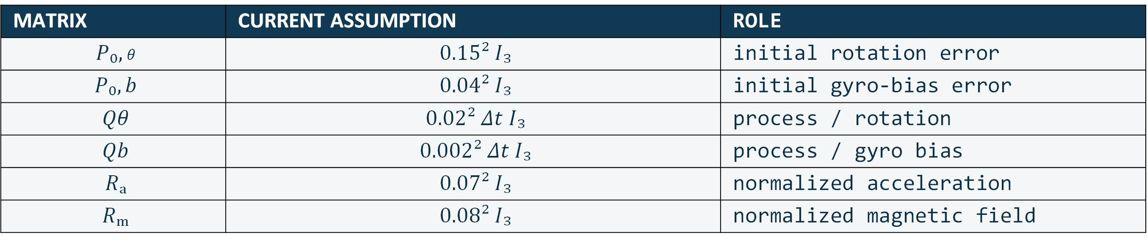
Estimation
UNCERTAINTY PRODUCES THE KALMAN CORRECTION
INNOVATION
UNCERTAINTY
GAIN
ERROR UPDATE
$$ν = z − h(x̂⁻)$$
$$S = HP⁻Hᵀ + R$$
$$K = P⁻HᵀS⁻¹$$
$$δx̂ = Kν$$
$$q̂⁺ = q̂⁻ ⊗ δq(δθ̂) b̂_g⁺ = b̂_g⁻ + δb̂_g$$
MATRIX | CURRENT ASSUMPTION | ROLE
$$P₀,θ$$ | $$0.15² I₃$$ | initial rotation error
$$P₀,b$$ | $$0.04² I₃$$ | initial gyro-bias error
$$Qθ$$ | $$0.02² Δt I₃$$ | process / rotation
$$Qb$$ | $$0.002² Δt I₃$$ | process / gyro bias
$$Rₐ$$ | $$0.07² I₃$$ | normalized acceleration
$$Rₘ$$ | $$0.08² I₃$$ | normalized magnetic field
The Kalman gain is not manually tuned: it emerges from our uncertainty models.
Notes:
~90 seconds. For either unit-vector observation, residual nu=z-h(q_hat^-), H=[[h]_cross,0] has size 3×6, covariance P^- is 6×6 and R is 3×3, so innovation covariance S=H P^- H^T+R is 3×3. Gain K=P^- H^T S^-1 is 6×3; delta-x_hat=K nu splits into delta-theta_hat (first three) and delta-b_hat (last three). In attitude_filter.hpp update_vector(), ekf=ekf*Q4::delta(delta-theta_hat), normalize, bias=bias+delta-b_hat. The attitude correction is clipped to magnitude 0.25 rad to preserve the local approximation. For numerical stability covariance is first updated by Joseph form P_J=(I-KH)P^-(I-KH)^T+K R K^T (code variable M and N). After injecting the error, reset its mean to zero and transform covariance with reset Jacobian G≈diag(I3−0.5[delta-theta_hat]_cross,I3); the implementation symmetrizes P=0.5(G P_J G^T+(G P_J G^T)^T). Verify source values: constructor P0=diag(0.15²I3,0.04²I3); predict() Q_k=diag((0.02² Δt)I3,(0.002² Δt)I3); correct_accel() passes sigma=0.07, correct_mag() sigma=0.08, so R_a=0.07²I3, R_m=0.08²I3. Q is a first-order discrete approximation to diagonal spectral densities, with no cross-terms; the values are educational guesses, not sensor statistics identified from Allan variance, datasheets or SITL recordings. Both observation vectors are normalized, hence R_a and R_m apply to unit-vector residuals, not raw m/s² or Gauss. Proper engineering tuning compares innovation consistency and ground-truth attitude/bias in controlled SITL cases after sensor characterization. Distinguish R(q) rotation from R_a/R_m covariance, and predicted x_hat^- from corrected x_hat^+.

Slide 65
Material
FedericoDD/workshop-PX4/

Slide 66
Recap
UNDERSTAND WHAT IS A SENSOR
BUILD THE PREDICT / CORRECT LOGIC
EXPLAIN WHY WE NEED SENSOR FUSION

Slide 67
Next time
Lesson 1
Lesson 2
Lesson 3
BUILD
ESTIMATE
PERCEIVE
Hardware, PX4
IMU + EKF
Camera + Visual Odometry
07/10
14/10
21/10

Slide 68
RoverTech
Thank you!

